Slide 1
Deliverable One
CSCI221 Fall 2016

Slide 2
Summary of Goals
We hope to have a mostly finished product at deliverable 3 and then debug for the next week
We are going to use a test driven approach and design test cases before writing the code fully.
We will use both user and unit test cases to ensure functionality
We will use Git and Github to create branches, master (the webpage), version-x (what we will be working on) and smaller branches of of version-x for each subteam
We hope to have a responsive, reliable, and user friendly experience that can be used after we have finished the class

Slide 3
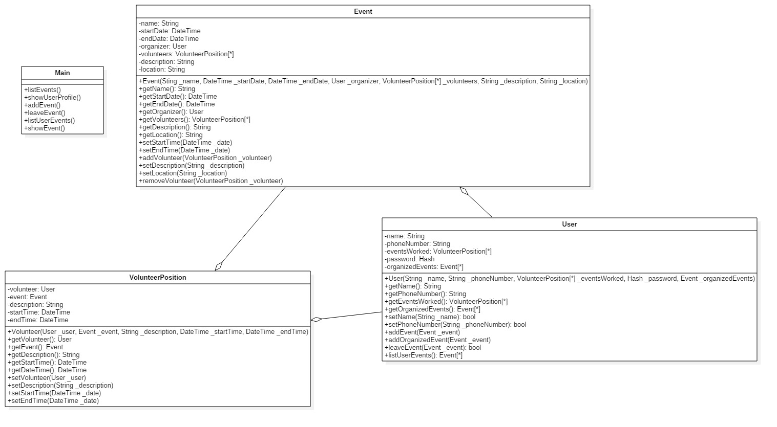
UML Diagram

Slide 4
User Stories
As a volunteer, I wish to participate in an event at specific dates, times, and locations, and also to be able to cancel my involvement at my discretion.
As a volunteer I would like to see a list of the events I am participating in and also view the events available.
As a volunteer I would like to see my personal profile information and be able to change my information if necessary. I would also like to see how many hours I have volunteered so far.
As an organizer I would like to set the times, dates, and locations for my event(s), as well as describe the event for volunteers. I would like to set the number of position(s) available to volunteers.
As an organizer I would like to have the ability to publicly post my event(s) for volunteers to sign up for.

Slide 5
Milestones for Deliverable 2
Implement Travis CI and test cases for all parts of the project
Have a landing page with functioning forums and fields, maybe have some base features working
Have the database up
Be able to send and receive basic data from the view and pass it to the database. Also receive data from the database

Slide 6
Milestones for Deliverable 3
Have the profile, home, and event pages up and functioning
Start securing the Database
Have the home,profile and event pages communicating with the database
Update and make more test cases if necessary

Slide 7
Milestones for Deliverable 4
All pages are up and fully functioning. No bugs or errors are present
Database is more secure and no bugs or errors
Properly linked all pages with the database, there are no errors or bugs present
Website is fully deployed and functioning

